Slide 1
NUTRITIONASSISTANT APPLICATION
TEAM MEMBERS
JAI SREE A
ILAKKIYA G
HARIHARAN G
ANKIT KUMAR MAURYA R
MENTOR
Dr. Barakkath Nisha U

Slide 2
ABSTRACT
A web based tool is being planned for therapeutic nutrition prescriptions in clinical settings. The cloud based system would have the ability to calculate the nutritional requirements and to guide first line nutritional management to patients and clients automatically. Also, it serves as an electronic medical and dietetic record, and personalized nutrition consultation approach can be client can converse to his/ her personal dietitian at their own convenient setting. The implementation once done would invite more and more queries for personalized nutrition support rather than depending on the set menu plans as in the case of current online approaches. Authenticity of the consultant dietitian would also be ensured by the responsible team providing nutrition support.

Slide 3
PROBLEM STATEMENT
Now a days peoples are not eating healthy foods with respect to their health condition. If it happens continuously means, it will lead to obesity and any other health problems.
To avoid that the system will detect and recognize the food and evaluating the nutrient values present in the food.

Slide 4
LITERATURE SURVEY
Development of a cloud based solution for effective Nutrition Intervention in the Management of Lifestyle Diseases.
A Diet control fitness assistant application using Deep Learning based image classification.
Enhancing cloud and Big Data Systems for healthy food and information systems Practice.
Digital Nutrition Consultation among Hand-Held Device Users During COVID-19 Pandemic.
Effectiveness of Game-based Learning of a National Health e-Learning Network for nutrition education in elementary school.

Slide 5
EXISTING SOLUTION
https://foodzilla.io/
https://www.livestrong.com/myplate/
https://www.yummly.com/
https://www.noom.com/

Slide 6
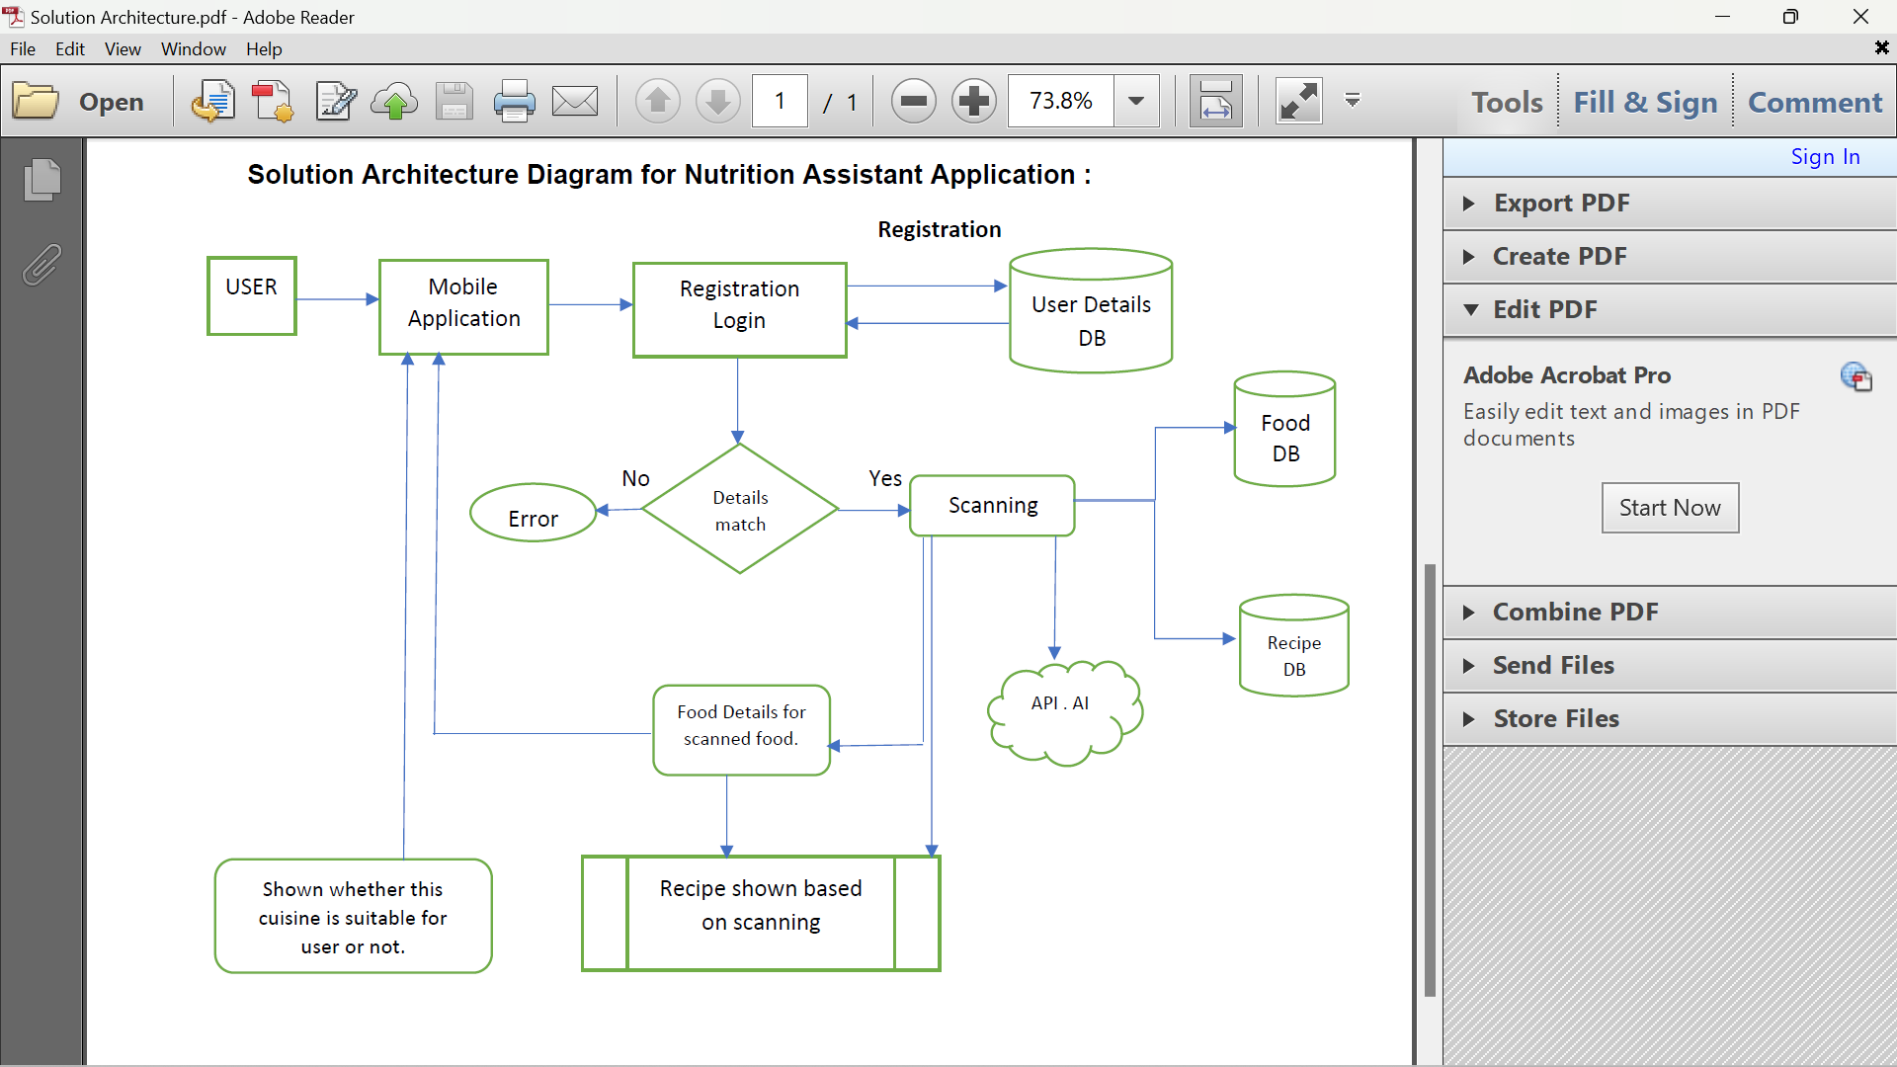
PROPOSED ARCHITECTURE

Slide 7
MODULE SPLIT UP AND EXPLANATION
S.No | MODULES | TEAM MEMBERS
1 | User Panel | Jai sree A Ilakkiya G Hariharan G Ankit Kumar Maurya R
2 | Admin Panel | Jai sree A Ilakkiya G Hariharan G Ankit Kumar Maurya R
3 | Chat Bot | Jai sree A Ilakkiya G Hariharan G Ankit Kumar Maurya R
4 | Final Delivery | Jai sree A Ilakkiya G Hariharan G Ankit Kumar Maurya R

Slide 8
EXPLANATION
USER PANEL- The user will login into the website and go through the products available on the website
ADMIN PANEL- The role of the admin is to check out the database about the stock and have a truck of all the things that the users are purchasing.
CHAT BOT- The user can directly talk to Chatbot regarding the products. Get the recommendations based on information provided by the user
FINAL DELIVERY- Container of applications using docker Kubernetes and development the application. Create the documentation and final submit the application

Slide 9
DATA SET/ INPUT
SPRINT 1
1.app.py
from flask import Flask, render_template, request, redirect, url_for, session
import ibm_db
import re
app = Flask(__name__)
app.secret_key = 'a'
conn = ibm_db.connect("DATABASE=bludb;HOSTNAME=ba99a9e6-d59e-4883-8fc0-d6a8c9f7a08f.c1ogj3sd0tgtu0lqde00.databases.appdomain.cloud;PORT=31321;SECURITY=SSL;SSLServerCertificate=DigiCertGlobalRootCA.crt;UID=ksm24043;PWD=ZXsdfH0rppztWofo",'','')
@app.route('/')
def home():
return render_template('register.html')
@app.route('/login', methods =['GET', 'POST'])
def login():
global userid
msg = ''
if request.method == 'POST'and 'username' in request.form and 'password' in request.form:
username = request.form['username’] password = request.form['password']

Slide 10
stmt = ibm_db.prepare(conn,'SELECT * FROM accounts WHERE username = ?AND password = ?')
ibm_db.bind_param(stmt,1,username)
ibm_db.bind_param(stmt,2,password)
ibm_db.execute(stmt)
account = ibm_db.fetch_assoc(stmt)
if account:
session['loggedin'] = True
session['username'] = account['USERNAME’]
msg = 'Logged in successfully !'
return render_template('index.html', msg = msg)
else:
msg = 'Incorrect username / password !'
return render_template('login.html', msg = msg)
@app.route('/logout')
def logout():
session.pop('loggedin', None)
session.pop('id', None)
session.pop('username', None)
return redirect(url_for('login'))
@app.route('/register', methods =['GET', 'POST'])

Slide 11
def register(): msg = ‘’ if request.method == 'POST’: username = request.form['username']
email = request.form['email']
password = request.form['password']
sql = "SELECT * FROM accounts WHERE username = ? "
stmt = ibm_db.prepare(conn,sql)
ibm_db.bind_param(stmt,1,username)
ibm_db.execute(stmt)
account = ibm_db.fetch_assoc(stmt)
print(account)
if account:
msg = 'Account already exists !'
elif not re.match(r'[^@]+@[^@]+\.[^@]+', email):
msg = 'Invalid email address !'
elif not re.match(r'[A-Za-z0-9]+', username):
msg = 'Username must contain only characters and numbers !'
elif not username or not password or not email:
msg = 'Please fill out the form !' else:
insert_sql = "INSERT INTO accounts VALUES (?, ?, ?)"
stmt = ibm_db.prepare(conn,insert_sql)
ibm_db.bind_param(stmt, 1, username) ibm_db.bind_param(stmt, 2, email)
ibm_db.bind_param(stmt, 3, password) ibm_db.execute(stmt) msg = 'You have successfully registered !'
elif request.method == 'POST’: msg = 'Please fill out the form !' return render_template('register.html', msg = msg)
if __name__ == '__main__': app.run(debug = True)

Slide 12
2.register.html
<html>
<head>
<meta charset="UTF-8">
<title> Register </title>
<link rel="stylesheet" href="{{ url_for('static', filename='style.css') }}">
</head>
<body></br></br></br></br></br>
<div align="center">
<div align="center" class="border">
<div class="header">
<h1 class="word">Register</h1>
</div></br></br></br>
<h2 class="word">
<form action="{{ url_for('register') }}" method="post">
<div class="msg">{{ msg }}</div>
<input id="username" name="username" type="text" placeholder="Enter Your
Username" class="textbox"/></br></br>
<input id="email" name="email" type="email" placeholder="Enter Your
Email" class="textbox"/></br></br>
<input id="password" name="password" type="text" placeholder="Enter Your Password"
class="textbox"/></br></br>

Slide 13
<input type="submit" class="btn" value="Sign Up"></br>
</form>
</h2>
<p class="bottom">Already have an account? <a class="bottom"
href="{{url_for('login')}}"> Sign In here</a></p>
</div> </div> </body> </html>
3.login.html
<html>
<head>
<meta charset="UTF-8">
<title> Login </title>
<link rel="stylesheet" href="{{ url_for('static', filename='style.css') }}">
</head>
<body></br></br></br></br></br>
<div align="center">
<div align="center" class="border">
<div class="header">
<h1 class="word">Login</h1>
</div></br></br></br>
<h2 class="word">
<form action="{{ url_for('login') }}" method="post">
<div class="msg">{{ msg }}</div>

Slide 14
<input id="username" name="username" type="text" placeholder="Enter Your
Username" class="textbox"/></br></br>
<input id="password" name="password" type="password" placeholder="Enter Your
Password" class="textbox"/></br></br></br>
<input type="submit" class="btn" value="Sign In"></br></br>
</form>
</h2>
<p class="bottom">Don't have an account? <a class="bottom"
href="{{url_for('register')}}"> Sign Up here</a></p>
</div> </div> </body> </html>
4.index.html
<html>
<head>
<meta charset="UTF-8">
<title> Index </title>
<link rel="stylesheet" href="{{ url_for('static', filename='style.css') }}">
</head>
<body></br></br></br></br></br>
<div align="center">
<div align="center" class="border">
<div class="header">
<h1 class="word">Index</h1>

Slide 15
</div></br></br></br>
<h1 class="bottom">
Hi {{session.username}}!!</br></br> Welcome to the index page...
</h1></br></br></br>
<a href="{{ url_for('logout') }}" class="btn">Logout</a>
</div> </div> </body> </html>
5.style.css
.header{
padding: 5px 120px;
width: 150px;
height: 70px;
background-color: #236B8E;
}
.border{
padding: 80px 50px;
width: 400px;
height: 450px;
border: 1px solid #236B8E;
border-radius: 0px;
background-color: #9AC0CD;
}

Slide 16
.btn {
padding: 10px 40px;
background-color: #236B8E;
color: #FFFFFF;
font-style: oblique;
font-weight: bold;
border-radius: 10px;
}
.textbox{ padding: 10px 40px;
background-color: #236B8E;
color: #FFFFFF;
border-radius: 10px;
}
::placeholder { color: #FFFFFF; opacity: 1;
font-style: oblique; font-weight: bold;
}
.word{ color: #FFFFFF; font-style: oblique; font-weight: bold;
}
.bottom{
color: #236B8E;
font-style: oblique;
font-weight: bold;
}

Slide 17
SPRINT 2
1.mail.py
# importing libraries
from flask import Flask
from flask_mail import Mail, Message
app = Flask(__name__)
mail = Mail(app) # instantiate the mail class
# configuration of mail
app.config['MAIL_SERVER']='smtp.gmail.com'
app.config['MAIL_PORT'] = 465
app.config['MAIL_USERNAME'] = 'derinjose886@gmail.com'
app.config['MAIL_PASSWORD'] = 'lhmjtfrjwblfbgeq'
app.config['MAIL_USE_TLS'] = False
app.config['MAIL_USE_SSL'] = True
mail = Mail(app)
# message object mapped to a particular URL ‘/’
@app.route("/")
def index():
msg = Message('you have registered sucessfully',sender ='derinjose886@gmail.com',recipients = ['jeyabalamurugan0@gmail.com']
)msg.body = 'welcome !! to Nutri Lite'mail.send(msg)
return'Sent’ if __name__ == '__main__':
app.run(debug = True)

Slide 18
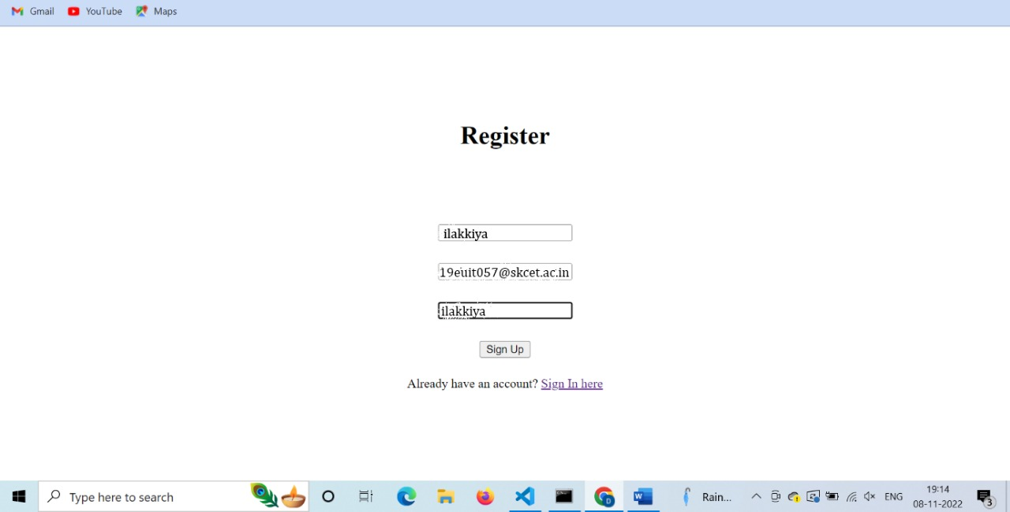
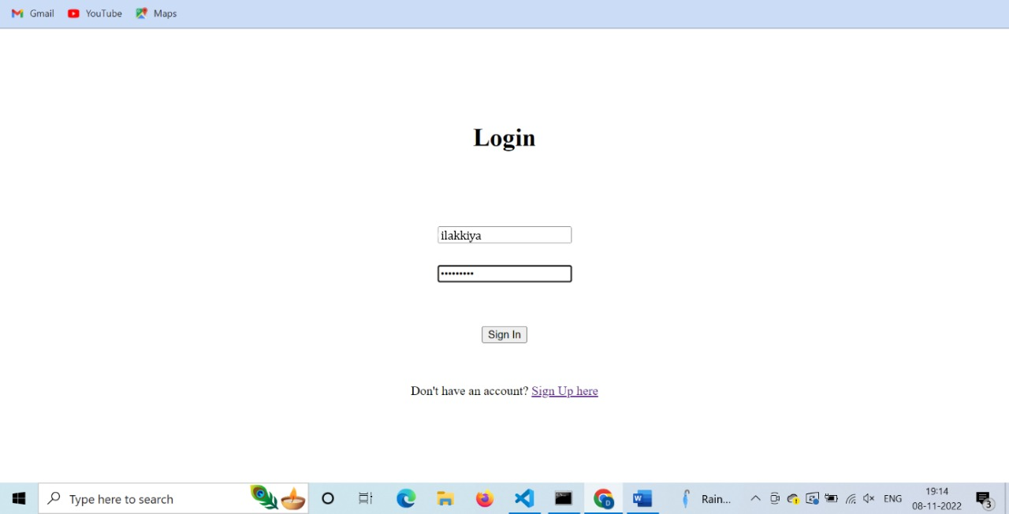
OUTPUT OF MODULES
SPRINT 1

Slide 19
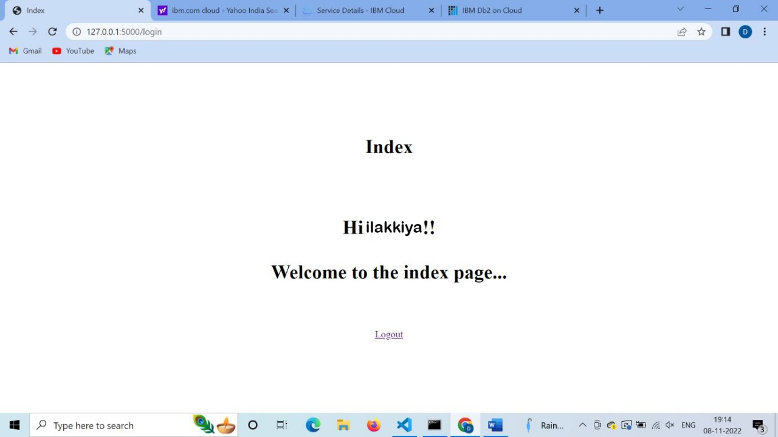
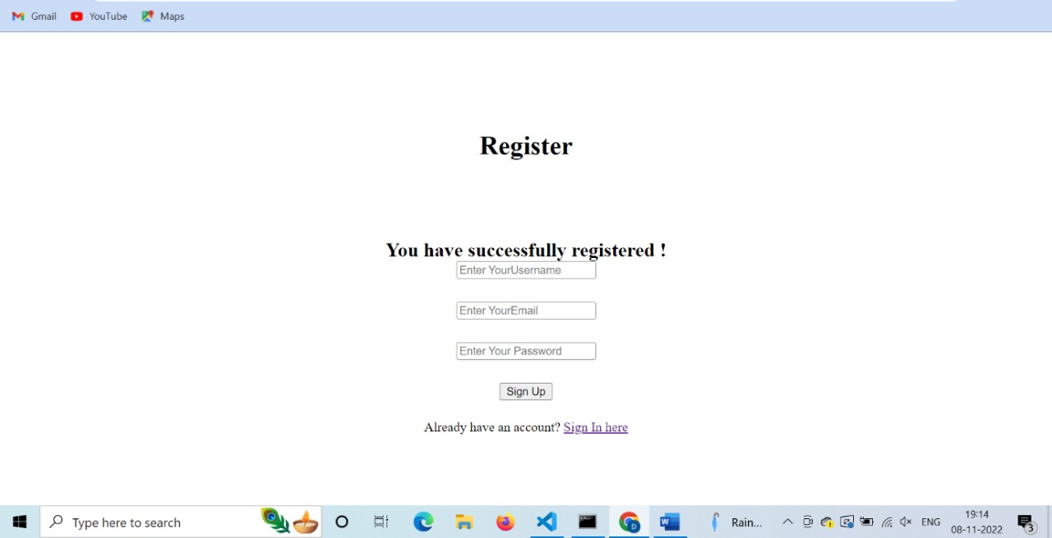

Slide 20
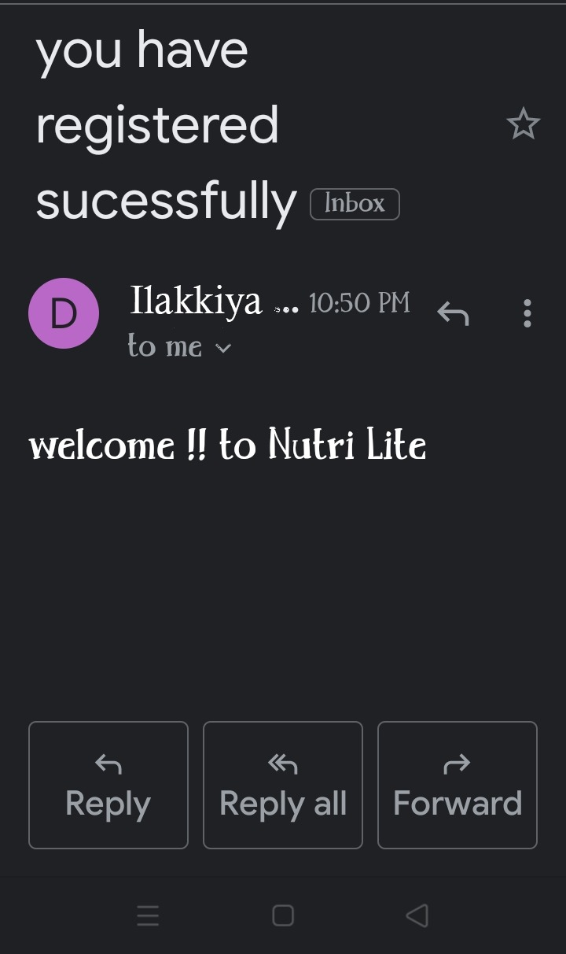
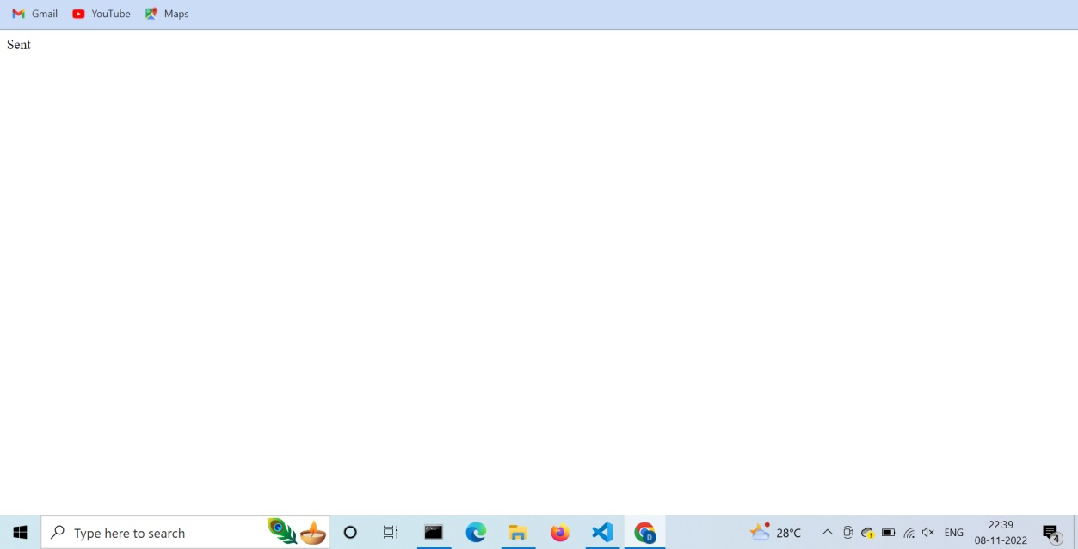
SPRINT 2

Slide 21
CONCLUSION
Dietary assessment is a necessary component of nutritional status assessment of individuals, and also is useful for other purposes. It can be done using a variety of methods, each of which has advantages and limitations. However, regardless of which method is chosen, it is important that certain criteria be met. Intake from all sources (food, fortified food, beverages, and nutrient supplements) must be included. Sufficient numbers of days to represent usual intakes must be obtained. Complete food and supplement composition tables must be employed. Appropriate reference standards and statistical procedures for assessing intakes must be used. Dietary assessment methods work best in combination with other methods for the assessment of nutritional status.

Slide 22
REFERENCE
https://www.researchgate.net/publication/346411010_DEVELOPMENT_OF_A_CLOUD_BASED_SOLUTION_FOR_EFFECTIVE_NUTRITION_INTERVENTION_IN_THE_MANAGEMENT_OF_LIFESTYLE_DISEASES
https://www.academia.edu/43016077/A_DIET_CONTROL_AND_FITNESS_ASSISTANT_APPLICATION_USING_DEEP_LEARNING_BASED_IMAGE_CLASSIFICATION
https://www.researchgate.net/publication/322152435_Enhancing_Cloud_and_Big_Data_Systems_for_healthy_Food_and_Information_Systems_Practice_A_Conceptual_Study
https://www.researchgate.net/publication/357303031_Digital_Nutrition_Consultation_among_Hand-Held_Device_Users_During_COVID-19_Pandemic
https://ieeexplore.ieee.org/document/5406187

Slide 23
THANK YOU

